Slide 1
CHAPTER 6: JavaScript validation
CLO5: Create interactive web pages using current standards-compliant client-side web technologies.

Slide 2
Document Revision CONTROL (DRC)
X.Y
X: Major change
Y: minor change
Version | Author | Effective Date | Change Description | DRC No
1.0 | Dr Madeleine Togher | August 2022 | 1st Version | 001

Slide 3
Lecture Notes
Contents of lectures are based on the textbook, recommended text, and supplementary material
Please read Chapter Z of the e-textbook from page X to page Y

Slide 4
LECTURE OUTLINE
Introduction
External JavaScript File
Form Data Validation
Key Terms
JavaScript Regular Expressions
Client Side Validation
Example – Form Validation with HTML 5 and Regular Expression

Slide 5
INTRODUCTION – client Side Validation
Client Side Validation provides a better user experience by responding quickly at the browser level.
The user inputs will be validated in the user's browser itself.
Client Side validation does not require a round trip to the server, so the network traffic which will help your server perform better.
Done on the browser side using script languages such as JavaScript.
If user enters an invalid email format, you can show an error message immediately before the user moves to the next field.
Users can correct every field before they submit the form.
Dependent on the JavaScript Language, so if users turn JavaScript off, it can easily bypass and submit dangerous input to the server.
Client Side Validation however can not protect your application from malicious attacks on your server resources and databases.
Notes:
Instructor Notes:
Student Notes:

Slide 6

Client-Side Validation
HTTP Request
HTTP Response
Web Browser
Web Server
Application Server
Database Server
JavaScript Validation
Application Validation
Client-side validation gives user faster feedback as it happens before form is submitted

Slide 7
Agenda
External JavaScript
Form Data Validation

Slide 8
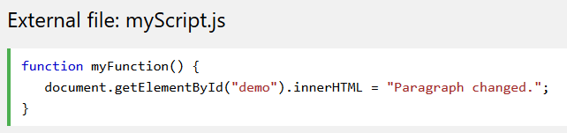

External JavaScript file
External scripts are practical when the same code is used in many different web pages.
JavaScript files have the file extension .js
How to use in HTML? Place an external script reference in <head> or <body> as you like.
External .js file does not contain <script> tags.

Slide 9

External JavaScript Advantages
Placing scripts in external files has some advantages:
It separates HTML and JS code thus makes HTML and JavaScript easier to read and maintain
To add several script files to one page - use several script tags in HTML file:
External Reference

Slide 10
Form Data Validation

Slide 11
Data Validation
Data validation is the process of ensuring that user input is correct and useful before it is submitted.
Typical validation tasks are:
has the user filled in all required fields?
has the user entered a valid date, email, address, name?
has the user entered text in a numeric field?
has the user entered number in a correct range?
Server side validation is performed by a web server, after input has been sent to the server.
Client side validation (HTML5 and JavaScript) is performed by a web browser, before input is sent to a web server.

Slide 12
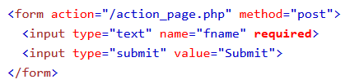
HTML Form Validation
HTML form validation can be performed automatically by the browser
For example, if a form field (fname) is empty, the required attribute prevents this form from being submitted:

Slide 13

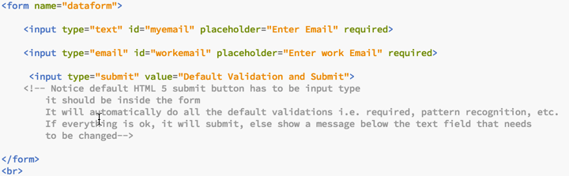
Example: HTML5 Email validation
HTML
HTML 5 provides some default validation which does not need JavaScript.
For additional complex validation, you will need to use JavaScript.

Slide 14
HTML Form References
HTML Forms
https://www.w3schools.com/html/html_forms.asp
HTML Form Elements
https://www.w3schools.com/html/html_form_elements.asp
HTML Input Types
https://www.w3schools.com/html/html_form_input_types.asp
HTML Input Attributes
https://www.w3schools.com/html/html_form_attributes.asp

Slide 15
JavaScript Regular Expressions
JavaScript can also be used to provide client-side data validation before an HTML form is submitted
Invalid form is not submitted until the errors are fixed
A regular expression is an object that describes a pattern of characters.
Regular expressions are used to perform pattern-matching on text
Regular expressions can be used to perform data validation

Slide 16
Example
/web/i is a regular expression
web a pattern to be used for matching
i for case insensitive matching
The method test() returns
true if pattern is FOUND in the string
false if pattern is NOT FOUND in the string
true

Slide 17
JavaScript Common Regular Expressions
https://www.w3schools.com/jsref/jsref_obj_regexp.asp
Expression | Description
/pattern/ | Pattern for exact matching
/pattern/i | Pattern for case insensitive matching
/[abc]/ | Pattern for matching any character between the brackets
/[0-9]/ | Pattern for matching any character between the brackets (any digit)
/(x|y)/ | Pattern for matching any of the alternatives specified
n{X} | Matches any string that contains a sequence of X n's
n{X,Y} | Matches any string that contains a sequence of X to Y n's
n{X,} | Matches any string that contains a sequence of at least X n's
n$ | Matches any string with n at the end of it
^n | Matches any string with n at the beginning of it

Slide 18
Regular Expressions Examples
https://www.w3schools.com/jsref/jsref_obj_regexp.asp
Expression | test() method evaluates TRUE for following strings
/hct/ | “hct”
/hct/i | Case insensitive: “hct”, “Hct”, “HCT”
/[a-zA-Z]/ | “Ali”, “a&li8”, “8ali*”
/^[a-zA-Z ]*$/ | “Ali Ahmad”, “Ali”, “ali”
/^[a-zA-Z ]{4}$/ | “AliA”, “abid”, “al I”
/^[a-zA-Z]{4,}$/ | “AliAhmad”, “abid”, “AAhmad”
/^[a-zA-Z ]{4, 11}$/ | “Ali A”, “DBM College”
/^ci(s|a)[0-9]{4}$/ | cis1203, cia2503
/^(02|04|06)-[0-9]{6}$/ | 02-123456; 04-000987
Notes:
https://www.w3schools.com/js/js_regexp.asp

Slide 19
Example
Form data validation using HTML5 and external JavaScript with regular expressions

Slide 20
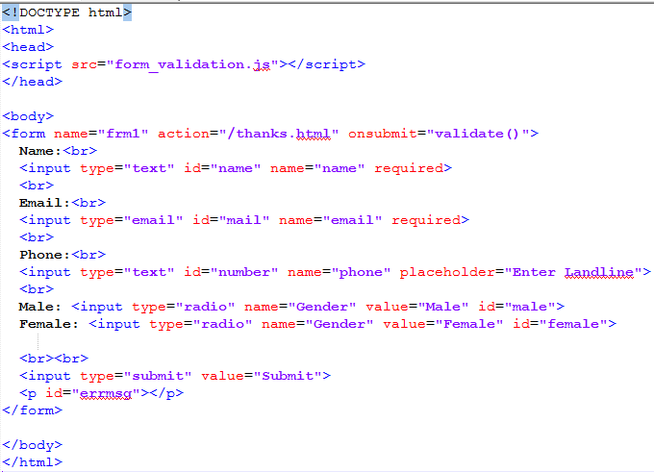
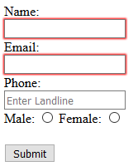
HTML Data Validation

Slide 21
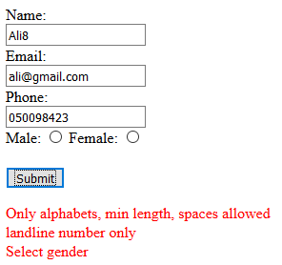
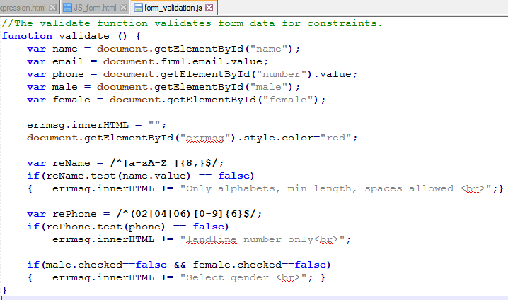
JS Data Validation

Slide 22
References
https://www.w3schools.com/default.asp
https://www.w3schools.com/jsref/jsref_obj_regexp.asp

Slide 23
KEY TERMS
Client side
required
Validation
Regular expression
External JavaScript
Notes:
Instructor Notes:
Student Notes:

